Slide 1





SAMPRAS Training
P&L and Billing
Presented by Irina Novak
May 27, 2008

Slide 2

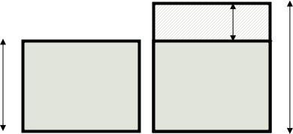
CVA Changes
Portfolio Level Results
Previous Current Difference Change (%)
CVA 359,546,231 368,184,042 8,637,811 2.402
DRE 70,794,344,428 73,027,576,534 2,233,232,105 3.155
Peak Exp 159,261,336,712 161,834,115,450 2,572,778,737 1.615
Avg Exp 20,079,721,031 20,371,284,530 291,563,499 1.452
Total MTM 6,532,130,481 6,681,147,327 149,016,846 2.281
Top 10 CVA movements
Counterparty SPN UCN Previous CVA Current CVA Difference
ITALIAN REPUBLIC 204668 009700386000 74,371,051 77,674,981 3,303,930
KBC ALTERNATIVE INVESTMENT MANAGEMENT LI 3505936 803047653000 1,863,391 2,042 -1,861,348
CRH AMERICAS INC 931284 002133114000 522,015 8,875 -513,140
THE GOVERNMENT OF THE KINGDOM OF SWAZILA 5115981 803631886000 5,271,945 4,764,883 -507,061
JEFFERSON COUNTY SEWER SYSTEM 2310473 801447335000 8,165,140 8,584,229 419,088
ELLINGTON CAPITAL GROUP LLC 2005026 801368507000 0 401,641 401,641
MORTGAGE INTEREST NETWORKING TRUST 2 LLC 7615078 006421762000 373,237 770,945 397,708
GM MORTGAGE OPPORTUNITY POOL 5405246 005035662000 583,899 921,944 338,044
ELLIOTT INTERNATIONAL LP 1941011 002389872000 4,162 295,085 290,923
CLEAR CHANNEL COMMUNICATIONS INCORPORATE 1588621 009562927000 2,518,274 2,743,812 225,538
CVA DIFF
CVA 0
CVA T

Slide 3
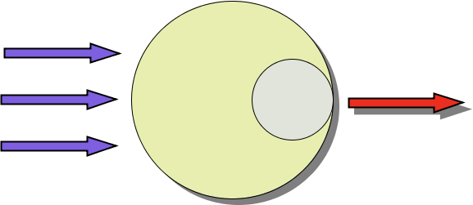
CVA Calculation
CVA represents the reserve that Credit Portfolio Group is holding to insure credit risk incurred by LOBs
A CVA increase represents a loss to the firm, and a decrease represents a profit
CVA changes broadly fit into three categories:
Changes in Market Data (e.g. Interest Rates)
Changes in Reference Data (e.g. Netting/Collateral agreements)
Changes to the Transaction Data (Portfolio) – New/Unwound/Edited deals
The principal behind the P&L Explain process is to:
Calculate the CVA under ‘normal’ conditions for the prior and current business days
Modify one parameter that has changed between the two dates and re-calculate CVA
Compare the two values to isolate and quantify the impact of that one change on CVA
Market Data
Sampras
CVA Calculator
Reference Data
CVA
Transaction Data

Slide 4







Total CVA Change
Base Run 0
M0
CVA
Calculator
CVA 0
R0
Sampras
T0
CVADIFF = CVA T – CVA 0
Base Run T
MT
CVA
Calculator
CVA T
RT
Sampras
TT

Slide 5





Market Movement P&L
Base Run 0
M0
CVA
Calculator
CVA 0
R0
Sampras
CVA 0 = f ( M 0, R 0, T 0 )
T0
P&L MM = CVA MM - CVA 0
Market Movement Run
MT
CVA
Calculator
CVA T
R0
Sampras
CVA MM = f ( M T, R 0, T 0 )
T0

Slide 6




Netting P&L
Market Movement Run
MT
CVA
Calculator
CVA MM
N0
Sampras
C0
CVA MM = f ( M T, N 0 , C 0, T 0 )
T0
P&L NET = f ( CVA NET , CVA MM )
Netting Run
MT
NT
CVA
Calculator
CVA NET
Sampras
CVA NET = f ( M T, N T , C 0, T NET )
C0
TNET

Slide 7

Collateral P&L
Netting Run
MT
NT
CVA
Calculator
CVA NET
Sampras
CVA 0 = f ( M T, N T , C 0, T 0 )
C0
T0
P&L COL = f ( CVA COL , CVA N )
Collateral Run
MT
NT
CVA
Calculator
CVA COL
Sampras
CVA COL = f ( M T, N T , C T, T COL )
CT
TCOL

Slide 8

Deal Activity P&L (Aggregate Level)
Base Run T
MT
CVA
Calculator
CVA T
RT
Sampras
CVA T = f ( M T, R T, D T )
DT
P&LACT = f (CVA T, CVA ACT )
Base Run T
MT
CVA
Calculator
CVA ACT
RT
Sampras
CVA ACT = f ( M T, R T, D T – U )
DT - U

Slide 9


Deal Activity P&L (Deal Level)
N 1
CVA N 1
N 2
CVA N 2
N 3
CVA N 3
U 1
CVA U 1
(DT, D0) =
U 2
CVA U 2
CVA N 1-n, U 1-n, E 1-n
CVA ACT
U 3
CVA U 3
E 1
CVA E 1
E 2
CVA E 2
E 3
CVA E 3

Slide 10
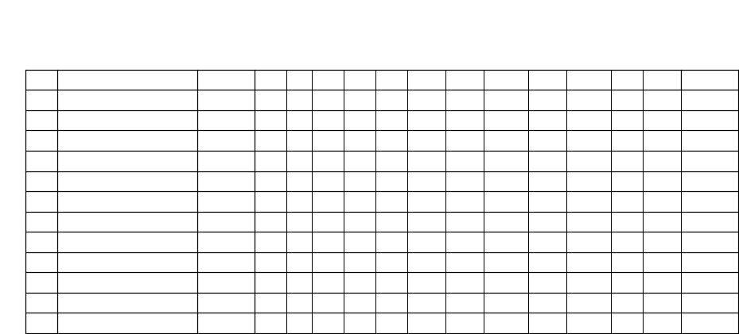
P&L Process
1
Previous Standard Run
Exp+CVA
C (
0
S0
E (
0
M0
EQ0
ED0
CD0
WW0
N0
CO0
P0 ))
2
Credit Spread Movement
CVA only
C (
0
ST
E (
0
M0
EQ0
ED0
CD0
WW0
N0
CO0
P0 ))
3
Bootstrapping Failure
CVA only
C (
0
ST
E (
0
M0
EQ0
ED0
CD0
WW0
N0
CO0
P0 ))
4
Wrong Way Impact
Exp+CVA
C (
0
S0
E (
0
MT
EQT
EDdb0T
CDT
WW0
N0
CO0
Pww0 ))
5
Total Market Movement
Exp+CVA
C (
0
S0
E (
0
MT
EQT
EDdb0T
CDT
WWT
N0
CO0
P0 ))
6
Market/Credit Correlation
CVA only
C (
0
ST
E (
0
MT
EQT
EDdb0T
CDT
WWT
N0
CO0
P0 ))
7
Netting changes
Exp+CVA
C (
0
ST
E (
0
MT
EQT
EDdb0T
CDT
WWT
NT
CO0
P0 ))
8
Collateral changes
Exp+CVA
C (
0
ST
E (
0
MT
EQT
EDdb0T
CDT
WWT
NT
COT
P0 ))
9
Credit Time Decay
CVA only
C (
0
S0
ES (
0
M0
EQ0
ED0
CD0
WW0
N0
CO0
P0 ))
10
Market Time Decay
CVA only
C (
0
S0
EA (
0
M0
EQ0
ED0
CD0
WW0
N0
CO0
P0 ))
11
Proxy Re-balancing
Exp+CVA
C (
T
ST
E (
T
MT
EQT
EDT
CDT
WWT
NT
COT
PpT ))
12
Current Standard Run
Exp+CVA
C (
T
ST
E (
T
MT
EQT
EDT
CDT
WWT
NT
COT
PT ))
13
SAMPRAS Time Decay
Exp+CVA
C (
T
S0
E (
T
M0
EQ0
EDdbT0
CD0
WW0
N0
CO0
P0 ))
Where:
C (T, St , E()) CVA (at Mid) as of time t, the credit spread St and the exposure profile E for a LEUCN
t = 0 Time of previous run
t = T Time of current run
St Counterparty Credit Spreads at time t (at Mid) – for CVA calculation
E (t,... P) Exposure profile at time t for portfolio P, and the specified scenario parameters
ES (t,...P) Exposure profile obtained by advancing the exposure profile at time t by T days
EA (t,...P) Exposure profile obtained by approximating the exposure profile to adjust for slide and convexity
Mt IR, FX & Equity market factors at time t (spot and volatility’s)
EQt Equity Derivatives Market Data at time t
EDt Energy Derivatives Market Data time t
EDdb0T Energy Derivatives Market Data at time T, with Futures Curves Days from Base at time 0 and Futures Curves Prices at time T
EDdbT0 Energy Derivatives Market Data at time 0, with Futures Curves Days from Base at time T and Futures Curves Prices at time 0
CDt Credit Spreads & Market Data for Credit Derivatives at time t
WWt Credit Spreads & Market Data for Wrong-Way at time t
Nt Netting data at time t
COt Collateral data at time t
Pt Portfolio at time t
PwwT Wrong Way Counterparty Portfolio at time t
PcdT Credit Derivative Counterparty Portfolio at time t
PpT Portfolio at time T, with proxy deals at time 0
Note: The Energy Derivatives Market Data version is adjusted for both the Market Movement run (and the runs that use the Market Movement run as a base) and SAMPRAS Time Decay run.

Slide 11

P&L Calculations
For each scenario, SAMPRAS returns either CVA values or impacts to the CVA values. Thus, if an impact is returned, no further calculation is necessary. The CVA change bucket calculation changes are as follows:
Note that: Cn = CVA for scenario n
In = Impact to CVA for scenario n
P&L Impacts:
Change in CVA due to Credit Spread Movements = CCS ≡ I2
Change in CVA due to recovery rate change from bootstrap failures = CRR ≡ I3
Change in CVA due to Total Market Movements = CTMM ≡ (C1 – C5)
Change in CVA due to Credit Time Decay = CCTD ≡ I9
Change in CVA due to Market Time Decay = CMTD ≡ I10
Change in CVA due to Market/Credit Correlation = CCMC ≡ (C5 – C6 – I2 – I3)
Change in CVA due to Netting = CNet ≡ C6 – C7
Change in CVA due to Collateral = CCol ≡ C7–C8
CVA change due to Deal Activity & Model/Cross = CDA ≡ C11 – C8 + I9 + I10
CVA change due to Proxy Re-balancing = CPR ≡ C12 – C11
Total of P&L Impacts = (CCS + CRR + CTMM + CCTD + CMTD + CCMC + CNet + CCol) – (CDA + CPR) = (C1 – C12)
P&L Breakouts:
Market Movement breakout:
Change in CVA due to Wrong-Way Market Data & Spreads = CWW ≡ (C4 – C5)
Change in CVA due to Market Data (without WW effects) = CMM ≡ (C1 – C5)
Deal Activity & Model/Cross breakout:
Change in CVA due to Deal Activity = CB (from Billing Run)
Change in CVA due to Model/Cross = CMC = CDA – CB

Slide 12




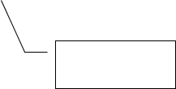


Credit Time Decay
Exposure
Exposure profile for the Credit Time Decay run
Exposure profile as of prior day
T-1
T
Time

Slide 13
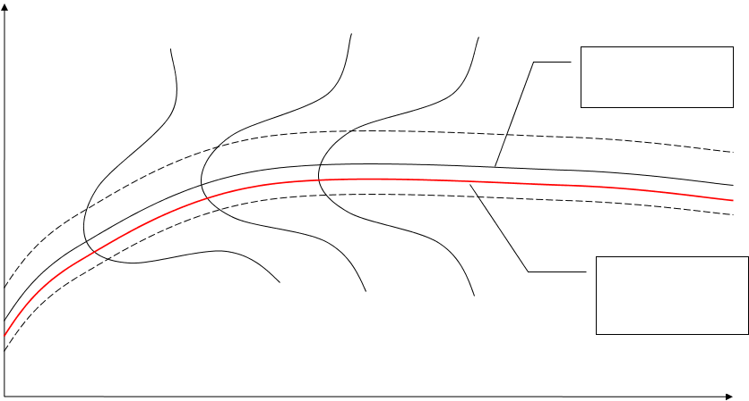
Market Time Decay
Exposure
Exposure profile as of prior day
Exposure profile for the Market Time Decay run
Time

